Slide 1
Network Layer and Attacks

Slide 2
Outline
The Role of the IP layer
IP Header
IP Fragmentation and Attacks
Routing
ICMP and Attacks

Slide 3
Network Layer
IP and ICMP
Addressing, forwarding and routing
Deliver packets to the transport layer
Provide error detection and diagnostic capability
Best effort service
Bandwidth guarantee – No
No-loss guarantee – No
Ordering – No
Timing – No
Congestion indication – No

Slide 4
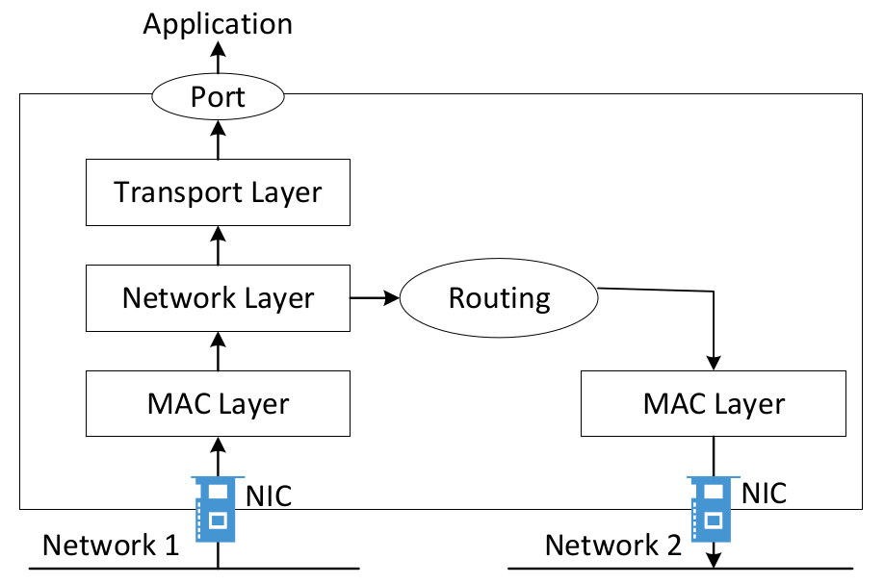
Packet Traversal

Slide 5
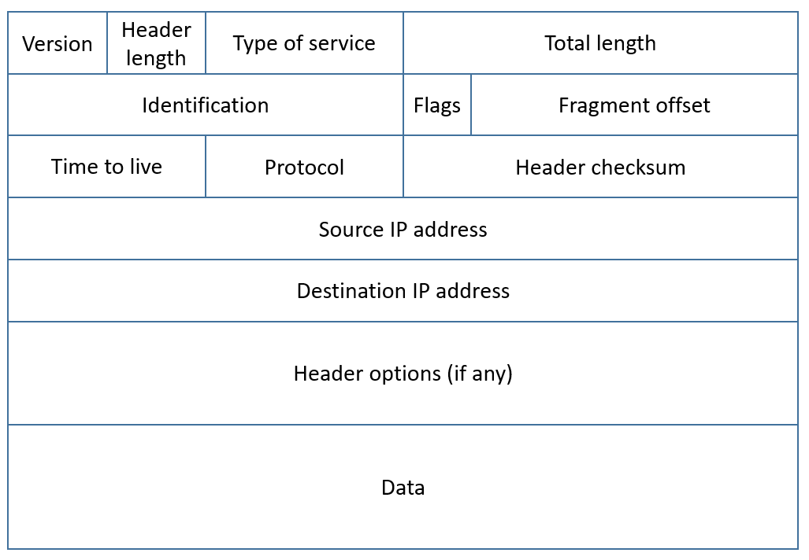
IPv4 Header
Notes:
Talk about each field of the IP header

Slide 6
IP Header
Version: For IPv4, this is always equal to 4
Internet Header Length (IHL): measured in units of four-byte blocks, minimum value is 5 (20 bytes), maximum is 15 (60 bytes)
Total Length: entire packet size in bytes, including header and data. The minimum size is 20 bytes (header without data) and the maximum is 65,535 bytes
Time To Live (TTL): Linux (64), Windows (128)
Protocol: defines the protocol used in the data portion of the IP datagram. ICMP (1), TCP (6), UDP (17)

Slide 7
TTL and How Traceroute Works
TTL = 1, 2, 3, …
At each router: TTL --
Packet discarded and trigger ICMP when TTL=0
Notes:
Talk about how traceroute works

Slide 8
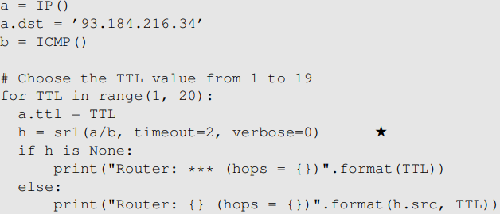
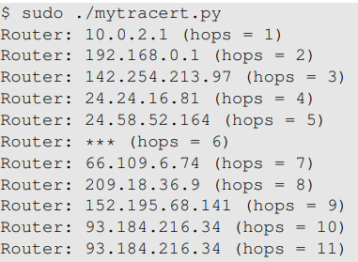
Implement traceroute

Slide 9
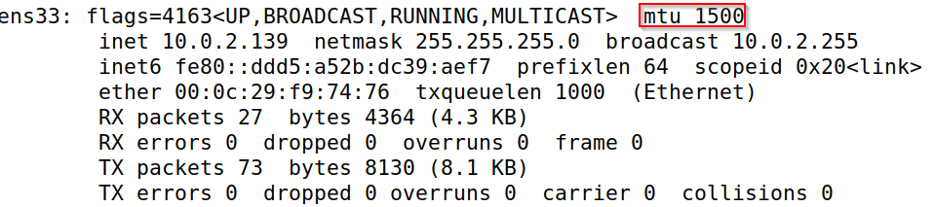
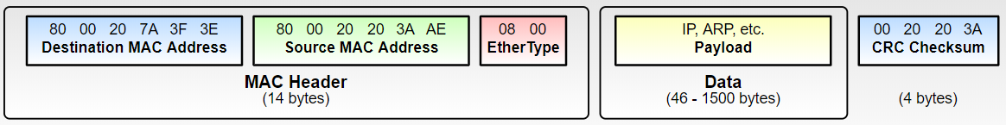
The Need for Fragmentation
Limit of packet size

Slide 10
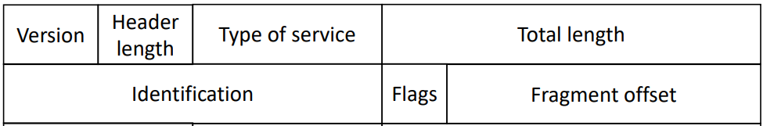
IP Header Fields for Fragmentation

Slide 11
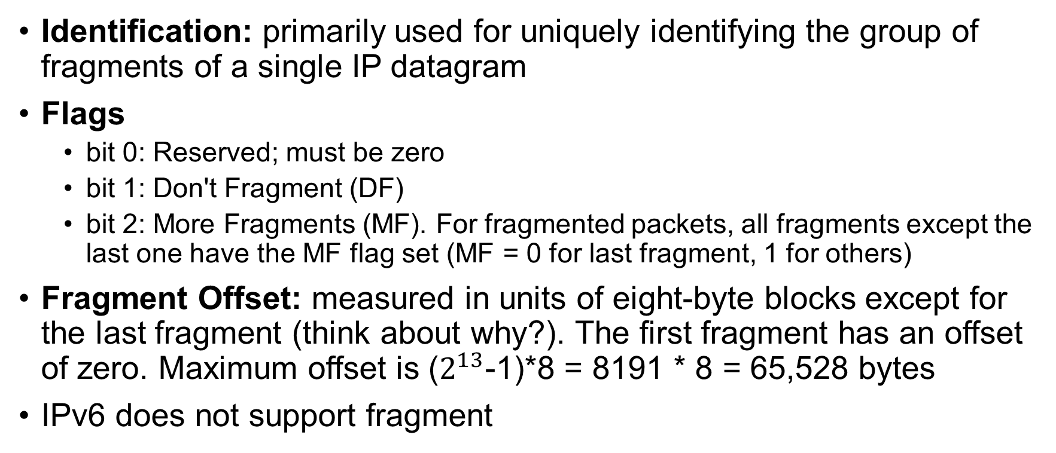
How IP Fragmentation Works
Identification: primarily used for uniquely identifying the group of fragments of a single IP datagram
Flags
bit 0: Reserved; must be zero
bit 1: Don't Fragment (DF)
bit 2: More Fragments (MF). For fragmented packets, all fragments except the last one have the MF flag set (MF = 0 for last fragment, 1 for others)
Fragment Offset: measured in units of eight-byte blocks except for the last fragment (think about why?). The first fragment has an offset of zero. Maximum offset is ($2^{13}$-1)*8 = 8191 * 8 = 65,528 bytes
IPv6 does not support fragment

Slide 12
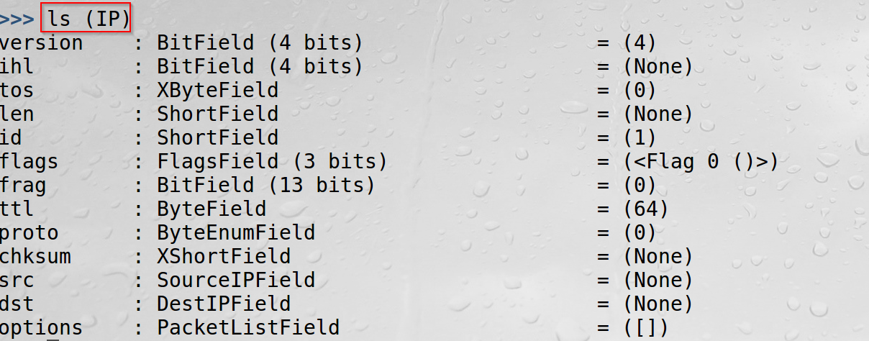
Scapy IP Class

Slide 13
An Example
A datagram of 4000 bytes (20 bytes of IP header plus 3980 bytes of IP payload) arrives at a router and must be forwarded to a link with an MTU of 1500 bytes.
length
=4000
ID
=333
flag
=0
offset
=0
Fragment | Bytes | ID | Offset | MF Flag
1st fragment
2nd fragment
3rd fragment
Notes:
1st fragment: Bytes=1500 (1480+20), ID=333, offset=0, Flag=1
2nd fragment: Bytes=1500 (1480+20), ID=333, offset=185, Flag=1
3rd fragment: Bytes=1040 (1020+20), ID=333, offset=370, Flag=0

Slide 14
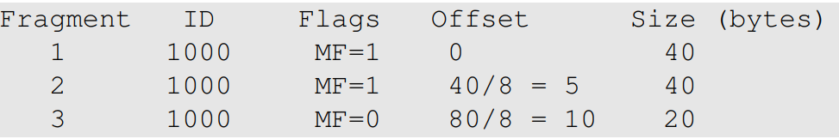
Another Example
Packet
ID field: 1000
IP Payload size: 100 bytes (UDP)
Break into 3 fragments, each with at most 40 bytes of payload

Slide 15
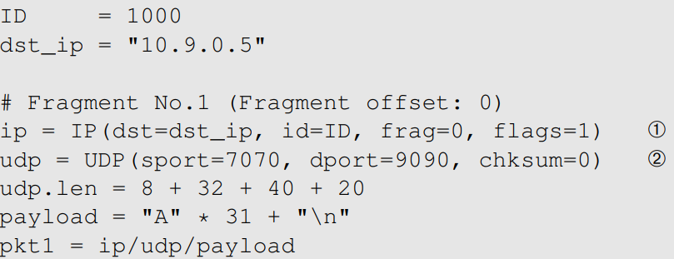
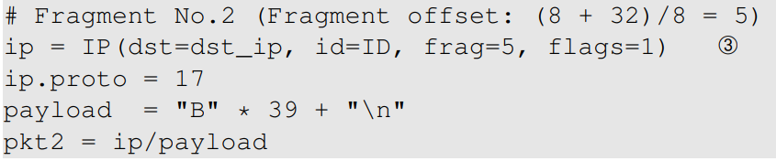
Build Fragments Manually (1)
Fragment 1
Fragment 2

Slide 16
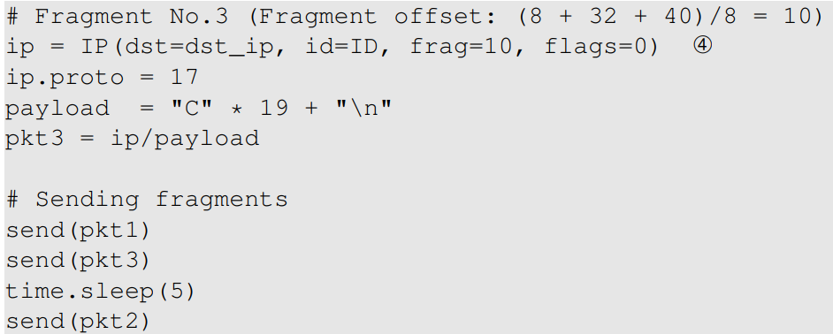
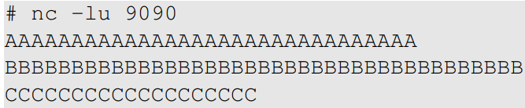
Build Fragments Manually (2)
Fragment 3
Execution Result

Slide 17
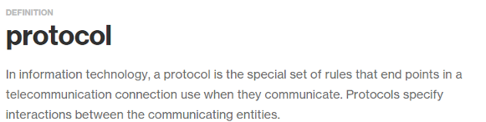
Attacks on IP Fragmentation

Slide 18
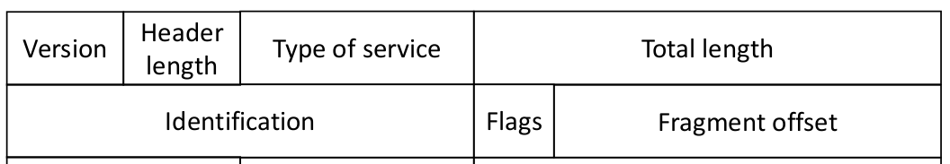
Attack 1: Tie Up Target's Resources
Question: Can you use a small amount of bandwidth to tie up a target machine's significant amount of resource?
Hint: use 2 small packets to cause server to allocate 64KB of RAM

Slide 19
Attack 2: Create a Super-Large Packet
Question: Can you create an IP packet that is larger than 65,535 bytes? (The Ping-of-Death Attack)

Slide 20
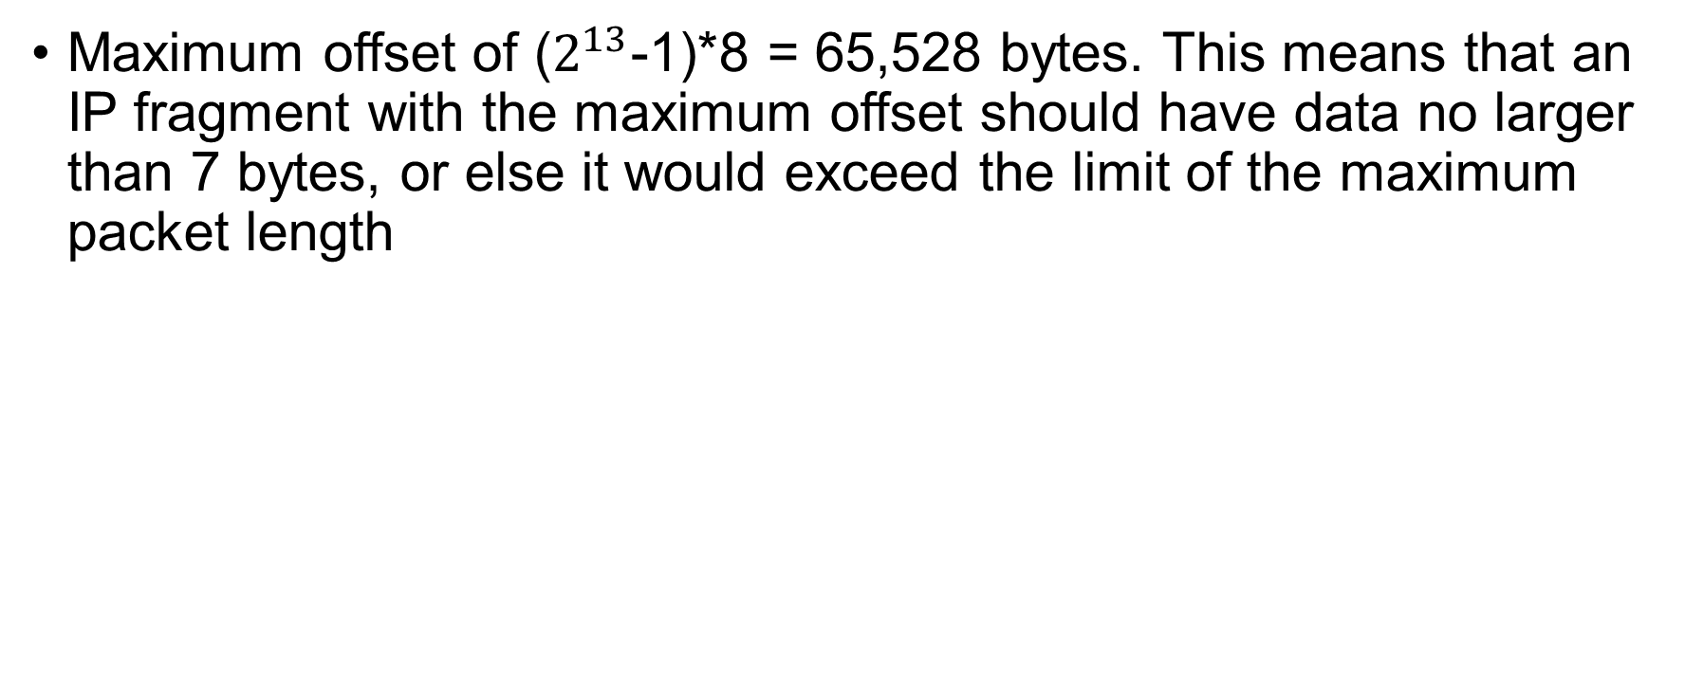
Ping of Death Attack
Maximum offset of ($2^{13}$-1)*8 = 65,528 bytes. This means that an IP fragment with the maximum offset should have data no larger than 7 bytes, or else it would exceed the limit of the maximum packet length
Notes:
>>> pkt=IP(dst='10.0.2.134')/ICMP()/('X'*60000)
>>> send(fragment(pkt))
Change 60000 to 70000 to see the difference

Slide 21
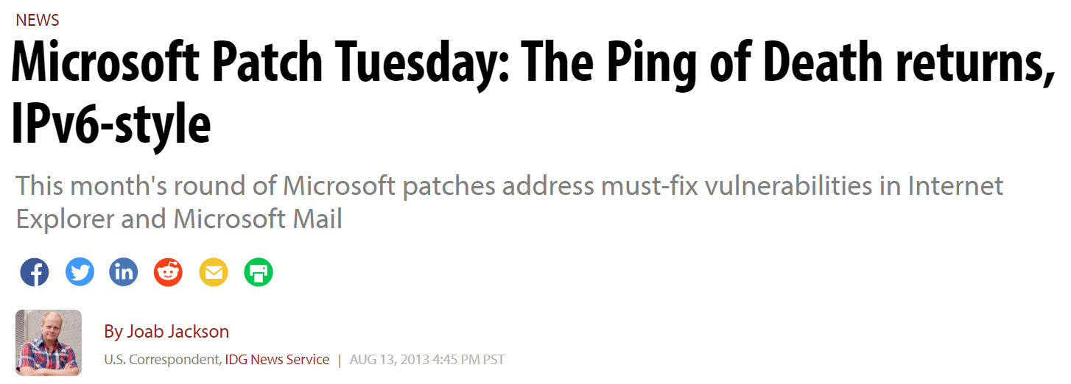
A Recent Ping of Death Vulnerability

Slide 22
Attack 3: Create Abnormal Situation
Question: Can you create some abnormal conditions using "offset" and "payload size"? (Teardrop Attacks)

Slide 23
Teardrop Attack
a denial-of-service (DoS) attack that involves sending fragmented packets to a target machine. Since the machine receiving such packets cannot reassemble them due to a bug in TCP/IP fragmentation reassembly, the packets overlap one another, crashing the target network device

Slide 24
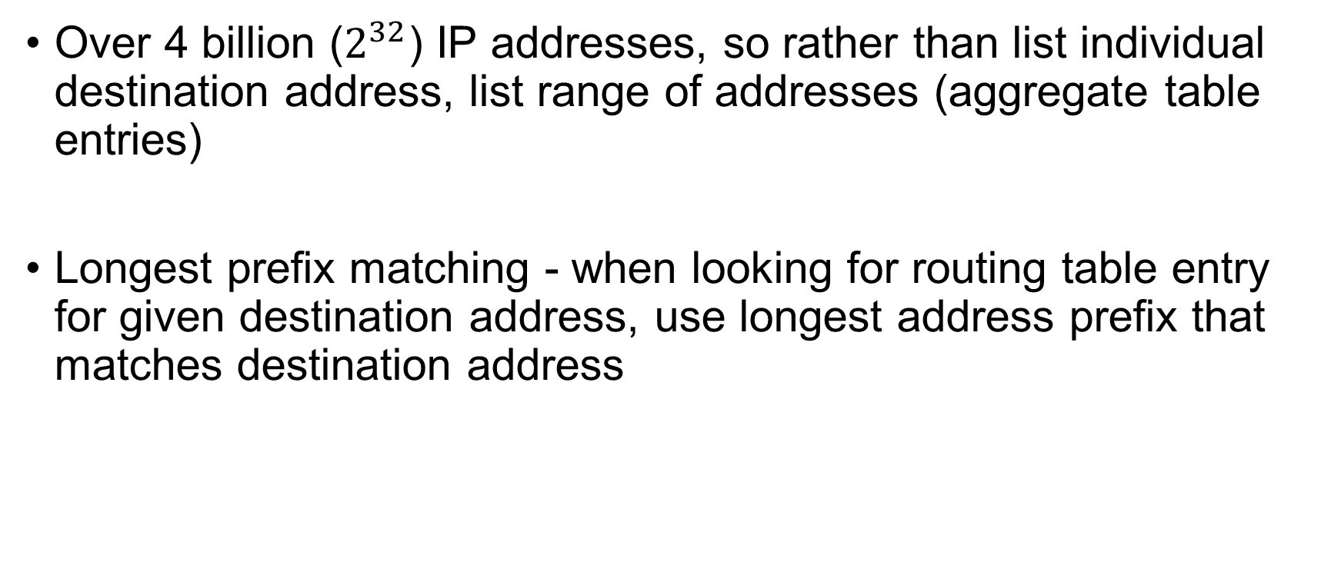
Routing (Forwarding) Table
Over 4 billion ($2^{32}$) IP addresses, so rather than list individual destination address, list range of addresses (aggregate table entries)
Longest prefix matching - when looking for routing table entry for given destination address, use longest address prefix that matches destination address

Slide 25
Routing Rules
Question: What interface will be used to route packets to
(1) 192.200.60.5?
(2) 192.168.30.5?
(3) 192.168.60.5?
Routing Entry | Packet 1 | Packet 2 | Packet 3
A: 0.0.0.0/0 dev interface-a
B: 192.168.0.0/16 dev interface-b
C: 192.168.60.0/24 dev interface-c
D: 192.168.60.5/32 dev interface-d

Slide 26
Routing Example
Destination Address Range |  | Link interface
200.23.16.0/21 | 1001000.00010110.00010000 | 0
200.23.24.0/24 | 1001000.00010110.00011000 | 1
200.23.24.0/21 | 1001000.00010110.00011000 | 2
otherwise |  | 3
Destination 200.23.22.161 which interface?
11001000.00010110.00010110.10100001
Destination 200.23.24.170 which interface?
11001000.00010111.00011000.10101010
Notes:
200.23.16.0/21- 1001000.00010110.00010000
200.23.24.0/24- 1001000.00010110.00011000
200.23.24.0/21- 1001000.00010110.00011000
200.23.22.161 interface 0
200.23.24.170 interface 1

Slide 27

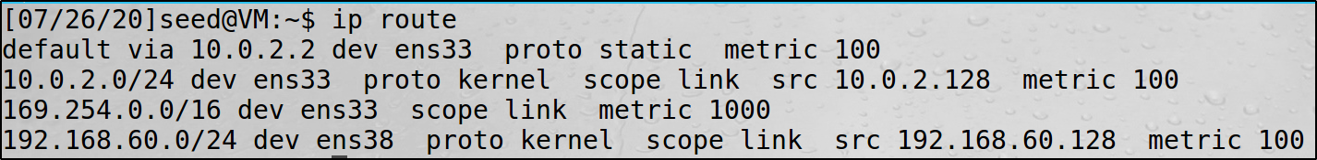


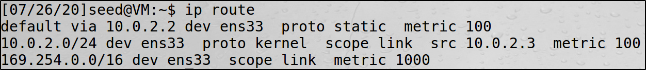

Routing Table
internet
10.0.2.2
10.0.2.128
10.0.2.3
192.168.60.128
192.168.60.2

Slide 28
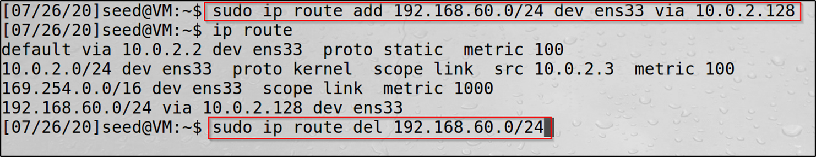
Change Routing Table
Add/delete an routing entry to/from the routing table
Notes:
Add routes on 10.0.2.3 to provide route to 192.168.60.0/24. There is no need to provide route on 192.168.60.2 to 10.0.2.0/24 as 192.168.60.128 is the default router

Slide 29
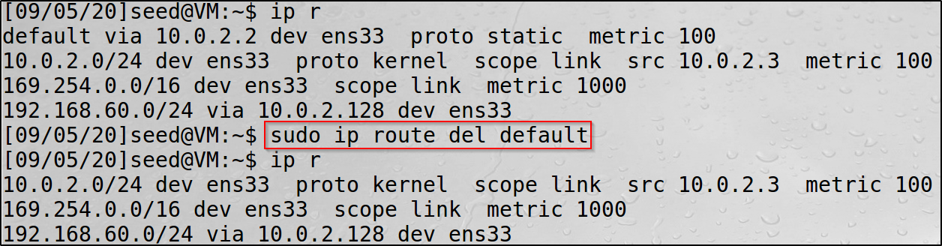
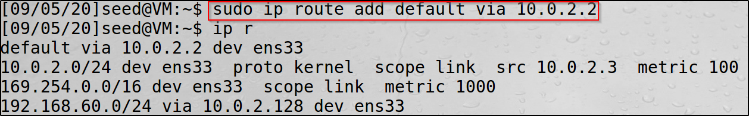
Change Routing Table
Add/delete the default gateway

Slide 30
How Are Routing Tables Configured
For routers
Routing protocols, OSPF, BGP, etc.
For hosts
DHCP
Using default routers
Manual configuration
ICMP redirect messages

Slide 31
Question
When do the destination IP address in the IP header and destination MAC address in the Ethernet header not represent the same computer?

Slide 32
Reverse Path Filtering (Spoofing Prevention)
Reverse path filtering is a mechanism adopted by the Linux kernel, as well as most of the networking devices out there to check whether a receiving packet source address is routable
If the reply to a packet wouldn't go out the same interface this packet came in, then this is a bogus packet and should be dropped

Slide 33
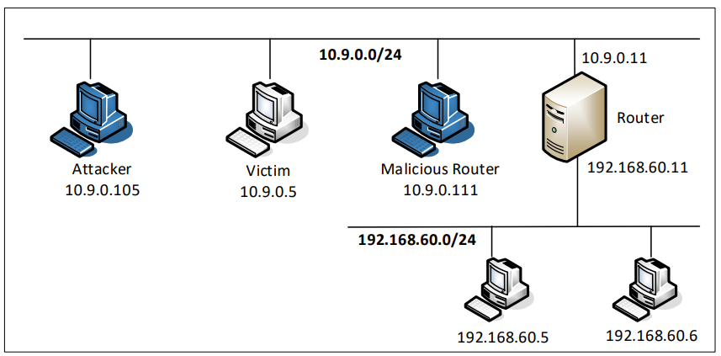
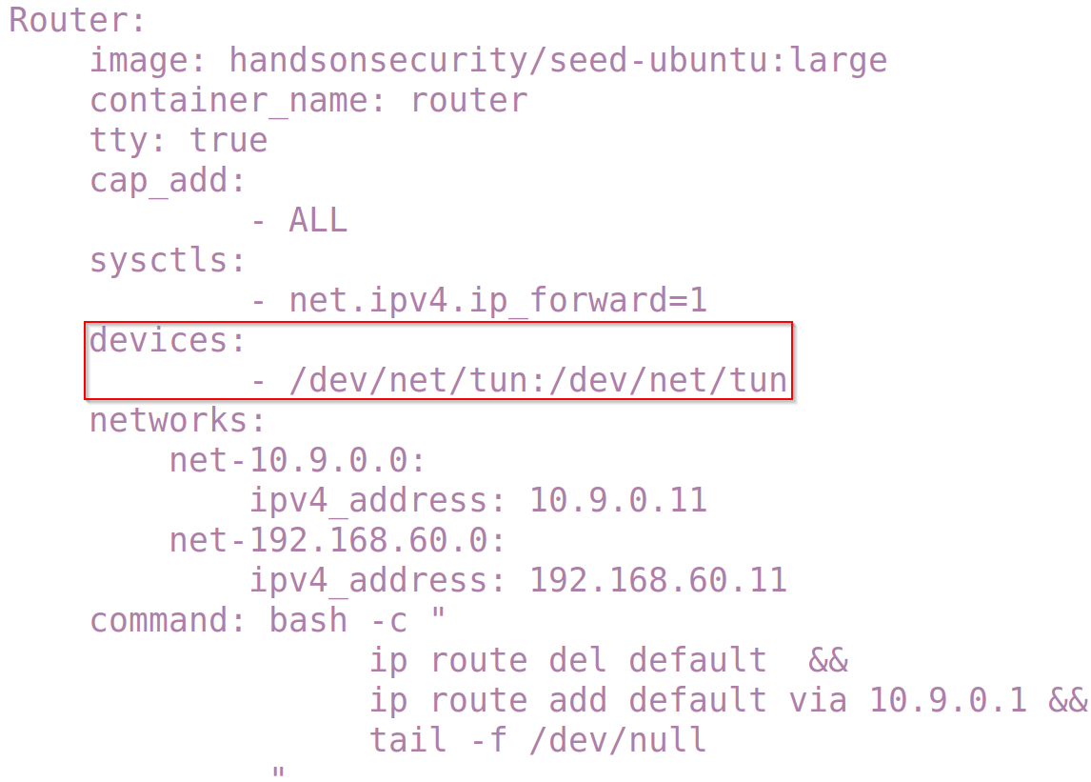
Reverse Path Filtering Experiment: Setup

Slide 34
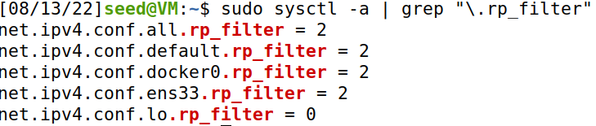
Reverse Path Filtering Setting in Ubuntu 20.04
On Ubuntu 20.04, by default, the reverse path filtering mechanism is only set to the loose mode
0: no checking on the source address, and asymmetric routing is allowed
1: Strict mode. Asymmetric routing is not allowed
2: Loose mode. Asymmetric routing is allowed, but the source address of the packet is checked against the routing table to ensure it is routable through one of the interfaces (any interface)

Slide 35
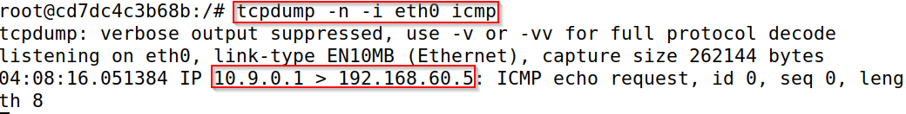
Problems Caused by Docker Container
Docker changes the source IP address of the spoofed packet to 10.9.0.1
Docker only does that if the spoofed source IP address comes from a virtual network created by docker (such as 192.168.60.0/24)

Slide 36
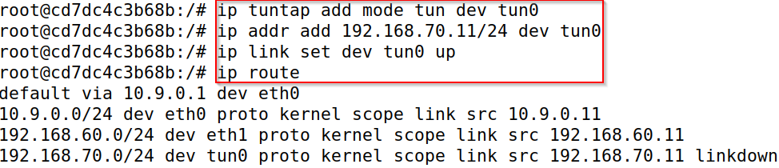
Problems Caused by Docker Container
We can get around this problem by creating another interface on the router container called tun0 and assign 192.168.70.11 as its IP address
Notes:
# ip tuntap add mode tun dev tun0
# ip addr add 192.168.70.11/24 dev tun0
# ip link set dev tun0 up

Slide 37
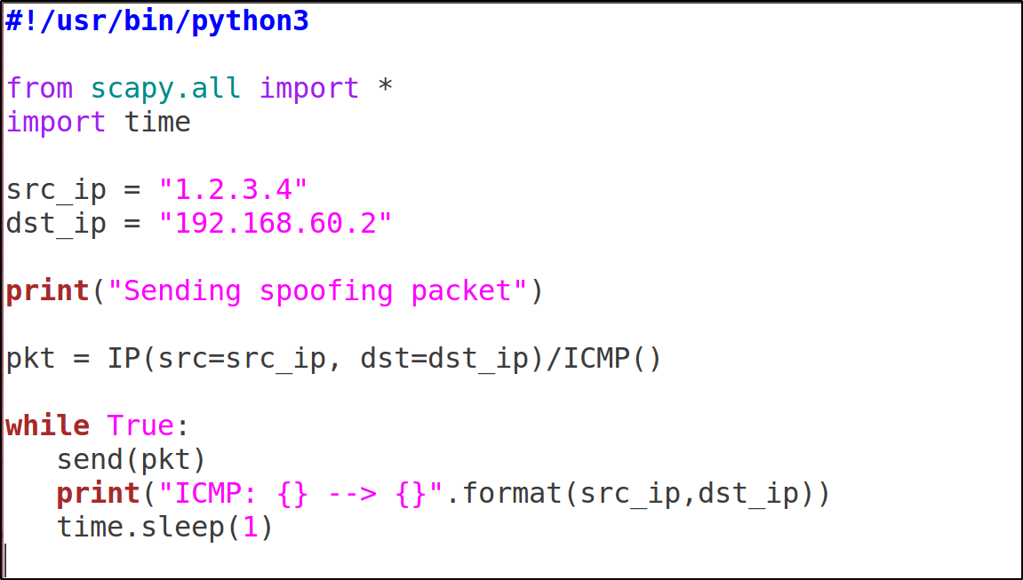
Demo Code
Notes:
Make sure the routing entries on the three VMs are correct

Slide 38
Internet Control Message Protocol (ICMP)
ICMP is a network-layer protocol. There is no port number associated with ICMP packets
ICMP messages are contained within standard IP packets as if it were a higher-level protocol, however, ICMP is actually an integral part of IP
Send Error messages
Send Operational information

Slide 39
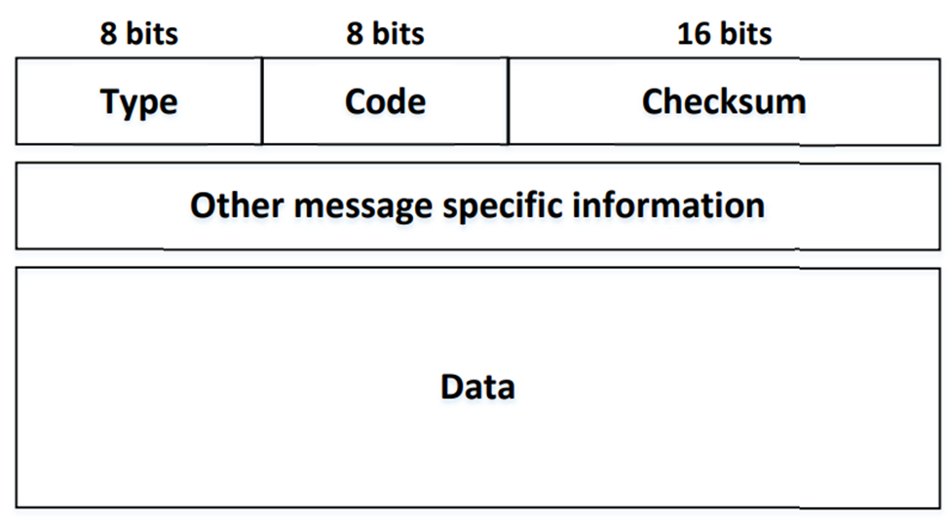
ICMP Header
Checksum: two bytes field calculated from the ICMP header and data
Rest of Header: Four-bytes field, contents vary based on the ICMP type and code
Data: ICMP error messages contain a data section that includes a copy of the entire IPv4 header, plus at least the first eight bytes of data from the IPv4 packet that caused the error message

Slide 40
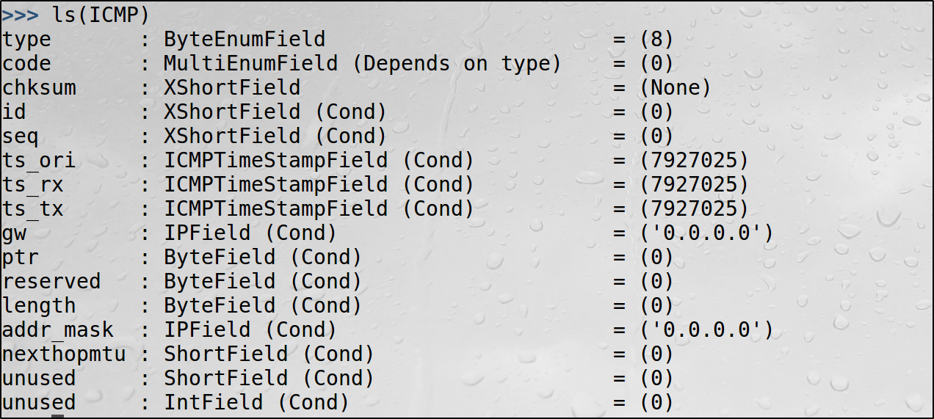
Scapy ICMP Class

Slide 41
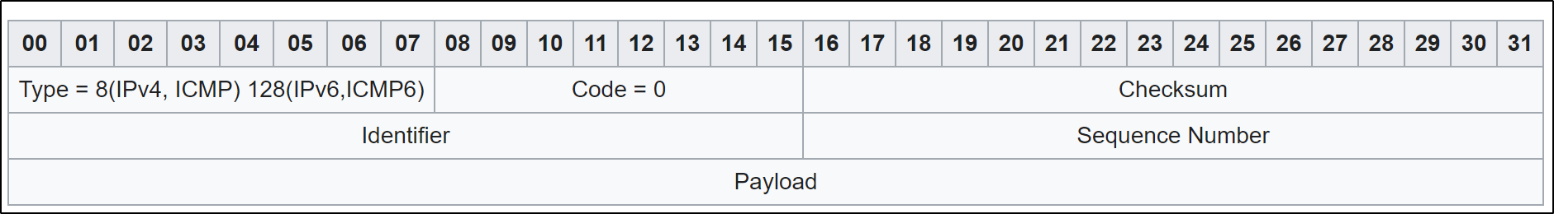
ICMP Echo Request
The Identifier and Sequence Number can be used by the client to match the reply with the request that caused the reply
Source: wikipedia

Slide 42
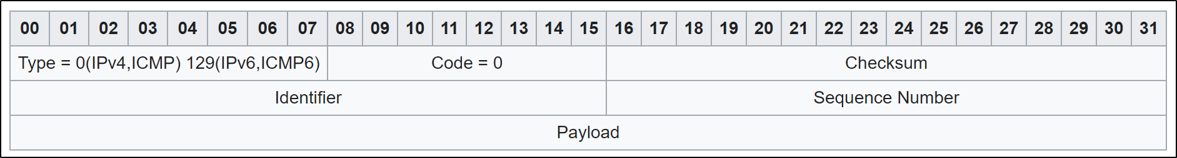
ICMP Echo Reply
The echo reply is an ICMP message generated in response to an echo request; it is mandatory for all hosts, and must include the exact payload received in the request
The identifier and sequence number must match those in the echo request
Source: wikipedia

Slide 43
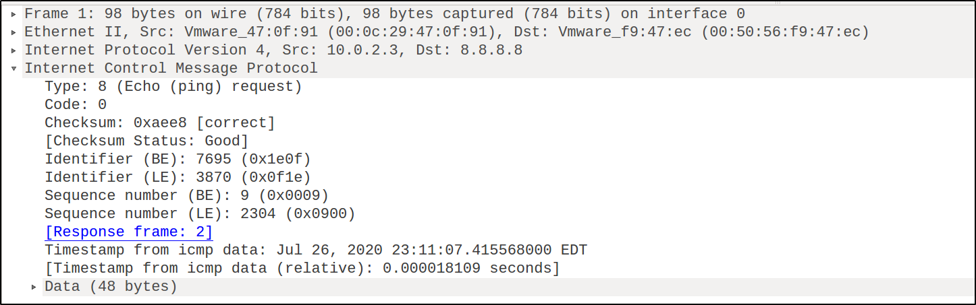
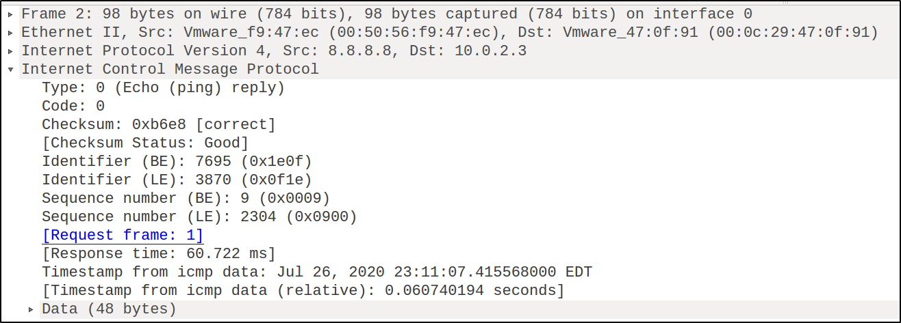
Captured ICMP Echo Request and Reply

Slide 44


Smurf Attack
The name comes from the idea of very small, but numerous attackers overwhelming a much larger opponent
The Smurf attack is a distributed denial-of-service (DDoS) attack in which large numbers of Internet Control Message Protocol (ICMP) packets (with the intended victim's IP as the spoofed source IP) are broadcast to a computer network using an IP directed broadcast address
If the number of machines on the network that receive and respond to these packets is very large, the victim's computer will be flooded with traffic

Slide 45
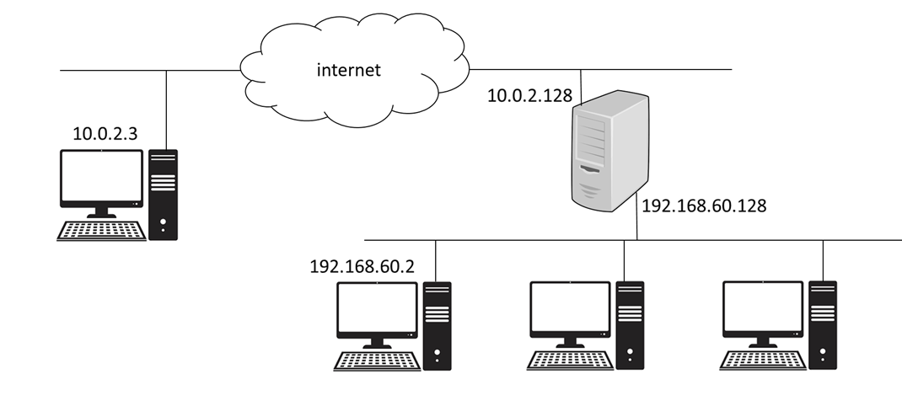
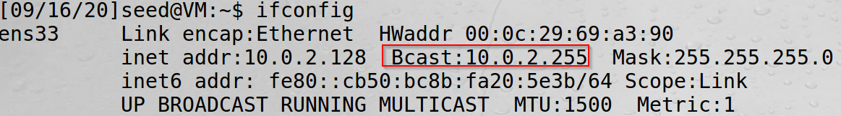
IP Directed Broadcast
IP broadcast address – 255.255.255.255 or netid.255
In IP directed broadcast, the router automatically translates directed broadcasts to physical broadcasts within your network. In other words, Layer 3 broadcasts to the IP broadcast address (10.0.2.255 for the subnet 10.0.2.0/24) are translated into Layer 2 broadcasts with an address appropriate for the interface (e.g., ff:ff:ff:ff:ff:ff for an Ethernet interface)

Slide 46
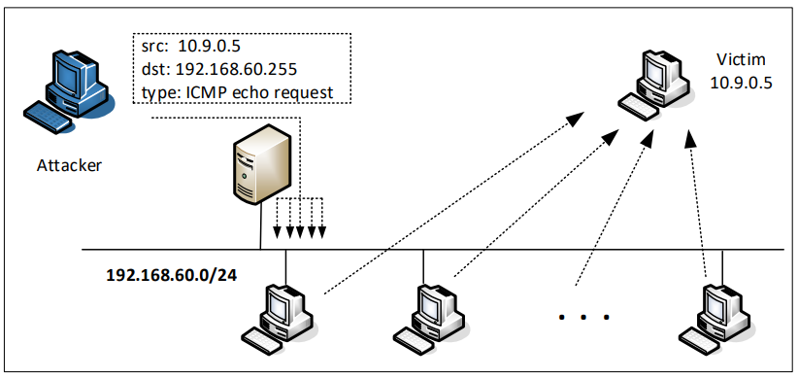
Smurf Attack
Direct broadcast address
Example: 192.168.60.255 for network 192.168.60.0/24

Slide 47
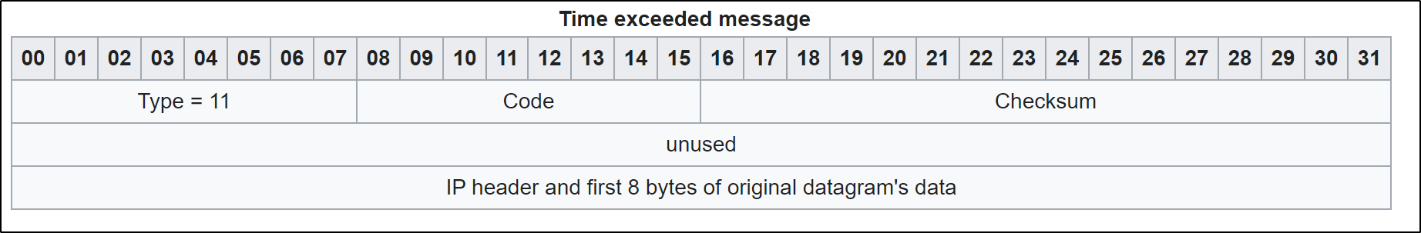
ICMP Time Exceeded
Time Exceeded is generated by a gateway to inform the source of a discarded datagram due to the time to live (TTL) field reaching zero
A time exceeded message may also be sent by a host if it fails to reassemble a fragmented datagram within its time limit
Code: Time-to-live exceeded in transit (0), Fragment reassembly time exceeded (1)
Source: wikipedia

Slide 48
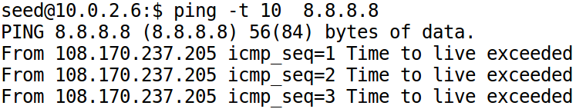
ICMP Time Exceeded
Type: 11
Code:
0: Time-to-live exceeded in transit
1: Fragment reassembly time exceeded
TTL=10

Slide 49
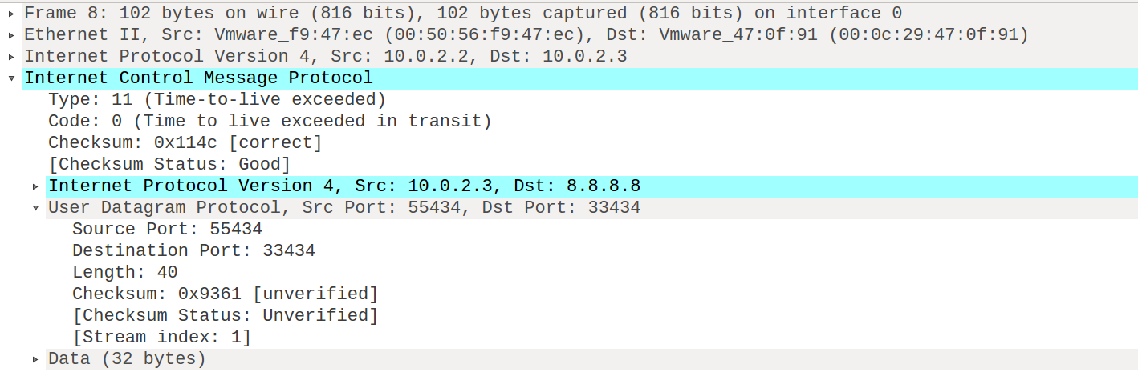
Captured ICMP Time Exceeded Packet

Slide 50
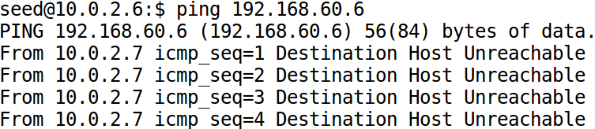
ICMP Destination Unreachable
Type: 3
Code
0: Destination network unreachable
1: Destination host unreachable
2: Protocol Unreachable
3: Destination port unreachable

Slide 51
ICMP Redirect
ICMP Redirect is a mechanism for routers to convey routing information to hosts
The ICMP Redirect message informs a host to update its routing information (to send packets on an alternative route)
If a host tries to send data through a router (R1) and R1 sends the data on another router (R2) and a direct path from the host to R2 is available (that is, the host and R2 are on the same local network), then R1 will send a redirect message to inform the host that the best route for the destination is via R2

Slide 52
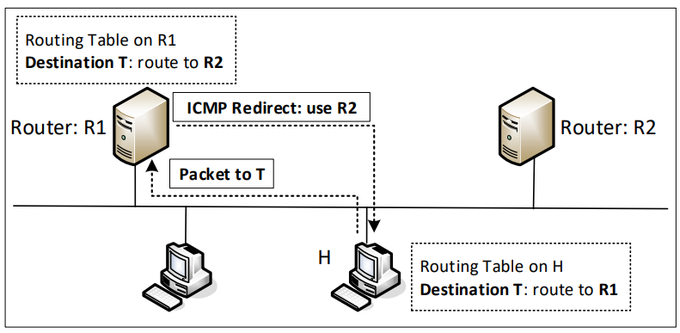
ICMP Redirect and Attacks
Notes:
Explain when this type of ICMP message is sent

Slide 53
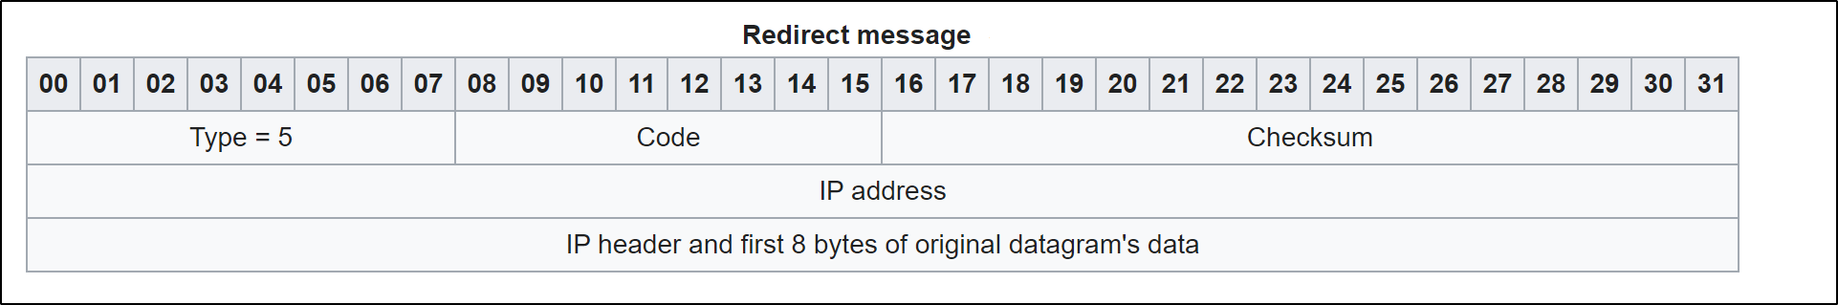
ICMP Direct Header
Code: redirect for Network (0), redirect for Host (1)
IP address: the 32-bit address of the gateway to which the redirection should be sent
IP header and additional data is included to allow the host to match the reply with the request that caused the redirection reply
Source: wikipedia

Slide 54
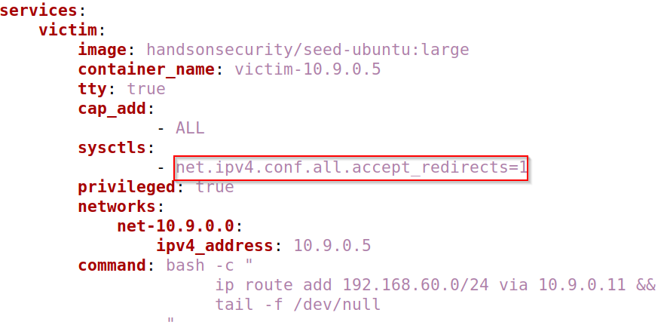
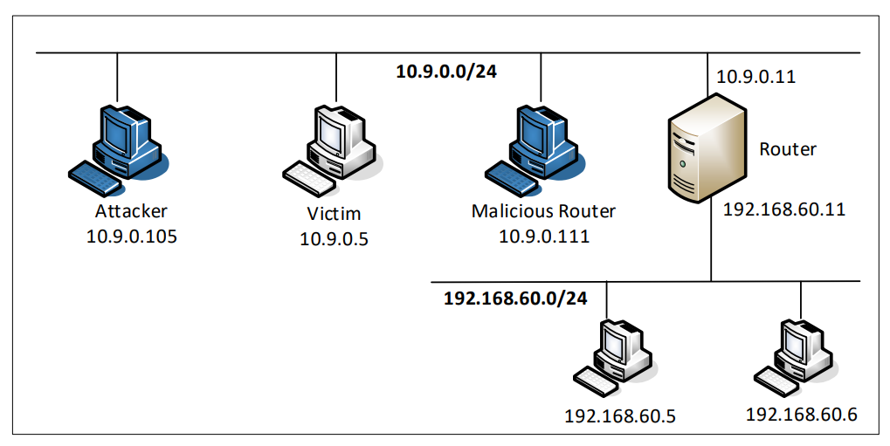
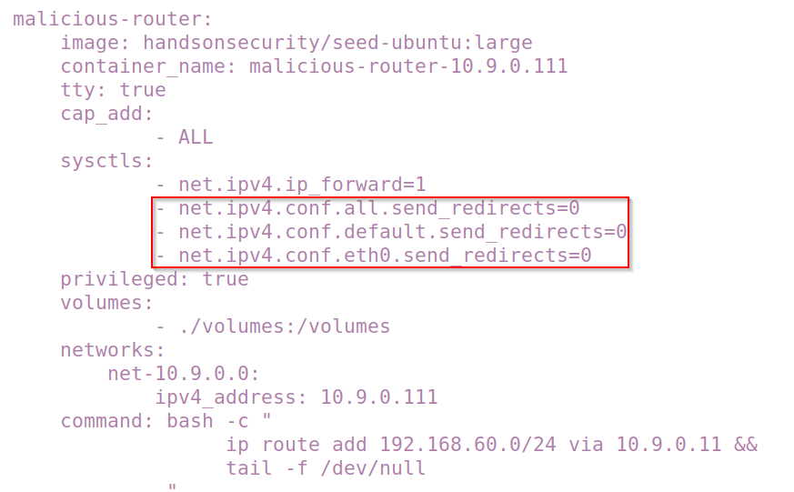
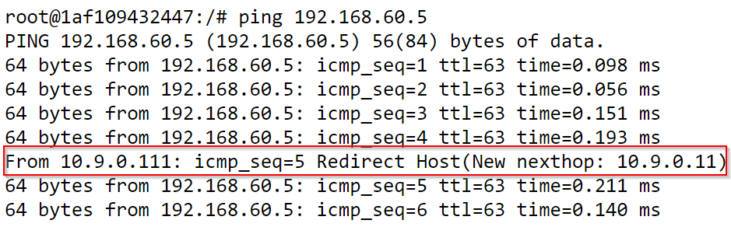
ICMP Redirect Attack Lab
Notes:
When they are set, after the attack is successful, the malicious router will receive the ping packet, but the kernel of the malicious router detects that the sender should send its packet directly to 10.9.0.11, so it sends out an ICMP redirect message (you can see it from the printout by the ping command). That changes the route cache from 10.9.0.111 back to 10.9.0.11. Therefore, to prevent this from happening, we have to ask the malicious router not to send out such ICMP redirect messages. Setting those parameters to zero achieves this purpose.

Slide 55
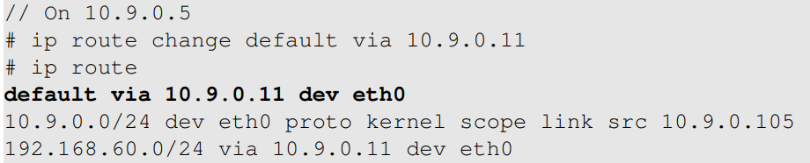

ICMP Redirect Experiment: Setup
Make 10.9.0.11 the default router
10.9.0.11’s default router is 10.9.0.1

Slide 56

ICMP Redirect Experiment
10.9.0.5 can directly send to 10.9.0.1: trigger ICMP redirect
After redirection (check 10.9.0.5)

Slide 57

ICMP Redirect Attack Demo
ICMP redirect messages will not affect the routing table; instead, it affects the routing cache
Entries in the routing cache overwrite those in the routing table, until the entries expire
To display and clean the cache contents, we can use the following commands
# ip route show cache
# ip route flush cache

Slide 58


Spoofing ICMP Redirect Message
Attack result
Notes:
According to the ICMP protocol, ICMP redirect message should contain a data section
that includes a copy of the entire IP header, plus at least the first eight bytes of data from the
IP packet that caused the redirect message. The data section is used by the host to see which
packet has caused the error message, so the recipient can know which route should be updated.
Moreover, on Ubuntu 20.04, the recipient of the ICMP redirect message will verify whether the
packet information enclosed in the data part is consistent with the packets that were sent out. If
not, the message will be dropped.

Slide 59
MITM Attack By Spoofing ICMP Redirect
Redirect traffic to attacker’s machines
Make changes before sending the packets out
Similar to the MITM attacking using the ARP cache poisoning attack

Slide 60

Which Filter to Use

Slide 61

Questions
Can you use the ICMP redirect attack to redirect the gateway to a remote computer?
Can you launch the ICMP redirect attack from a remote machine?

Slide 62

NAT: Network Address Translation
Notes:
Use this diagram to explain how the NAT works. There are several level of private networks in this diagram, each one has a NAT server.
Iptables –t nat –A POSTROUTING –j MASQUERADE –o eth0

Slide 63
Summary
The Role of the IP layer
IP Header
Routing
ICMP

